Slide 1
Performance Testing
Training Session - QAL

Slide 2
What is “Performance Testing”?
“Performance testing is the process by which a target system is tested for its capacity to withstand the current load and the future load.”
Primarily used for…
determining capacity of existing systems.
creating benchmarks for future systems.
Identifying bottlenecks for different scenarios.

Slide 3
Functional Testing & Performance Testing – A comparison
Functional Testing
Determines whether a product functions correctly according to its specifications and relevant documentation standards
Re-execution of one or more tests in subsequent build of the application/product to ensure
Revisiting and testing all prior bug-fixes in response to a new fix/enhancement
Re-testing all programs that might be affected by the fix/enhancement
Hidden Bugs are uncovered
The baseline for Regression Testing grows with every build
Performance Testing
Final stage of Software life cycle before going live
Simulation of realistic workloads
Execute load, stress, spike tests and volume tests
Record user experiences while using the application
Determine runtime “behavior” of the application and the supporting infrastructure
Ensure that the application meets the non functional requirements

Slide 4
Objectives of this course
Objectives
To understand performance testing concepts
Deep dive in to the performance testing processes
How to manage performance test requirements & estimation
Different kind of strategy and approach we can have
How to configure and execute a performance testing project
How to find the bottleneck from the test reports

Slide 5






Performance testing types
Load Testing
Modeling the expected usage by simulating multiple users accessing the program's services concurrently
Stress Testing
Determine the stability of a given system testing it beyond normal operational capacity
Reliability Testing
Determines how long the application can sustain optimum performance levels under expected loads
Scalability Testing
Determines how long the
application can scale up, be it user load supported, the number of transactions, the data volume etc
Volume Testing
Testing a software application for a certain data volume

Slide 6

How to mange a performance testing project?
Start of Project
Requirement Analysis
Test Design
Test Plan
Test Execution
Analysis of Results
Preliminary Reports
Executive Summary Report
Project Closure

Slide 7
Performance testing steps
INCEPTION
1
2
3
High Level Reqt. Gathering
Estimation
Detailed Reqt. Gathering
ELABORATION
4
5
6
7
8
Test Plan
App / Server / NW Evaluation
Tool Evaluation
BP Identification
Scenario Creation
CONSTRUCTION
9
10
11
12
13
Test Case/Script Creation
Test Scheduling
Environment Check
Test Execution
Result Compilation
TRANSITION
14
15
16
Training
Hand over process
Result Presentation

Slide 8
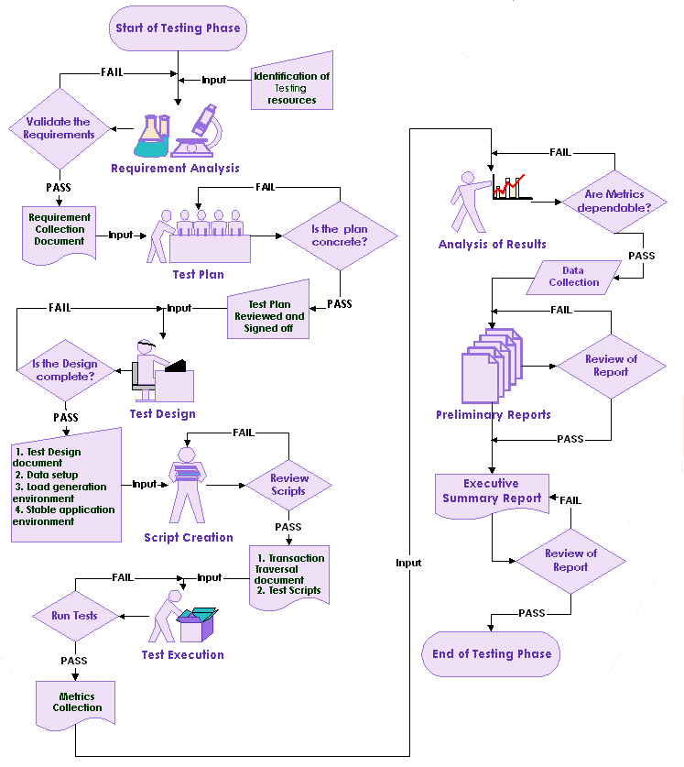
Performance Testing Approach

Slide 9



Engagement Models
Clients
Onsite-Offshore Model
Virtusa Offshore team
Virtusa Offshore Network
Project
Manager
VOIP
Virtusa QA
Processes
Business
Analysts
SME’s
Virtusa
SQA Practices
Onsite
Meetings
Virtusa onsite team
E Mails
Test
Schedule
Test Artifacts
Virtusa Offshore
Testing team
Execute
Desktop clients
Clients
Offshore Model
Virtusa Offshore team
Virtusa Sales team
Virtusa Offshore Network
Virtusa QA
Processes
Project
Manager
VOIP
Virtusa
SQA Practices
Test
Schedule
Virtusa Offshore
Testing team
Execute
Business
Analysts
SME’s
Onsite
Meetings
Test Artifacts
E Mails
Desktop clients
Clients
Onsite Model
Client Network
Virtusa Offshore team
Project
Manager
VOIP
Virtusa QA
Processes
Business
Analysts
SME’s
Onsite
Meetings
Test Artifacts
E Mails
Virtusa
SQA Practices
Virtusa onsite team

Slide 10
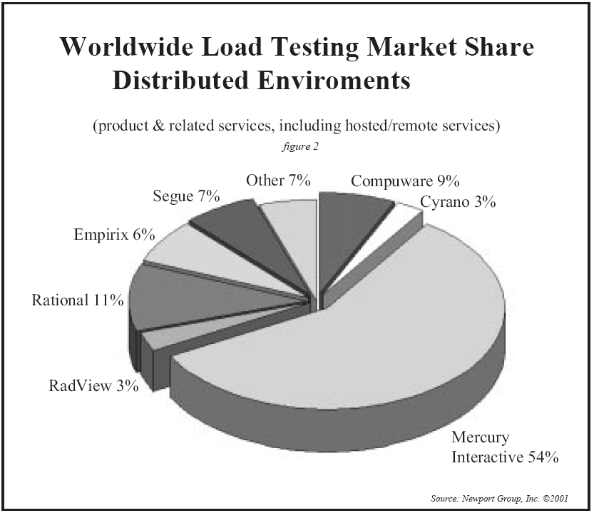
OUR VALUE PROPOSITION Market Leaders in Performance Testing Products
Distinct Advantage of Mercury
Interactive’s Load Runner Product
Wide protocol choices
Sophisticated tuning console
Integrated analysis module
Wide report choices
Wide variety of monitors
Integration with SiteScope
Integration with Diagnostics
Excellent after sales support

Slide 11
Requirement Management / Estimation Method
Performance Testing Process Guide/ Checklist
Complete guide to perform testing end to end
Different stages and the artifacts to be followed
Performance Testing Proposal
How to frame the proposal?
How to address the customer requirements?
Performance Testing Estimation
How to use the estimation model?
Tool evaluation
How to use the tool evaluation template?
How to recommend the tool

Slide 12
Design & Approach
Business process identification
Definition of business process
Identification of critical business processes
Grouping of business processes
Performance Test Plan
Framing the test strategy
Creating a test plan
Approach for load, stress, scalability tests etc..
Performance Test Scenario Development
How to assign users and load details to a business process
How to define the iterations

Slide 13
Test Execution
Performance Testing Environment Checklist
Hardware configuration
Application evaluation
Test case development
Transaction naming
Think time settings
Parameterization
Correlation
Test data management
Data grouping for multiple iterations
Data grouping for multiple users and iterations
How to define runtime settings for a scenario
Thinktime settings
Browser setting
Log file settings
Notes:
13

Slide 14
Performance test analysis & Basic Metrics
System Resources
CPU, Memory, Disk I/O
Web Server Resources
Threads, Cache Hit Ratio
Application Server Resources
Heap size, JDBC Connection Pool
Database Server Resources
Wait Events, SQL Queries
Transaction Profiling
Code Block Analysis
Bandwidth Utilization
Network delay time
Network Segment delay time
Running Vusers
Hits per Second
Throughput
HTTP Status Code
HTTP responses per Second
Pages downloaded per Second
Transaction response time
Page Component breakdown time
Component size Analysis
Error Statistics
Total Successful/Failed Transactions
Network Monitoring
Client Side Statistics
Server side metrics

Slide 15
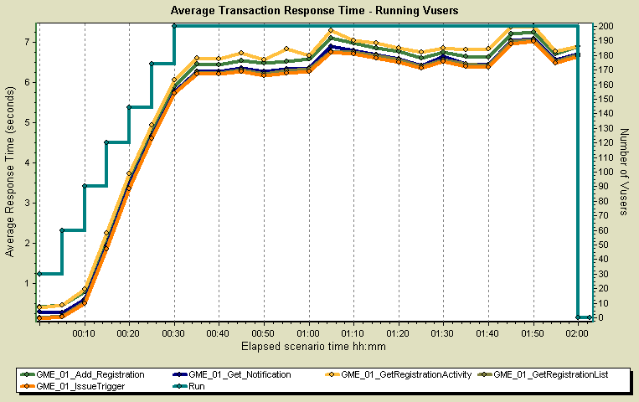
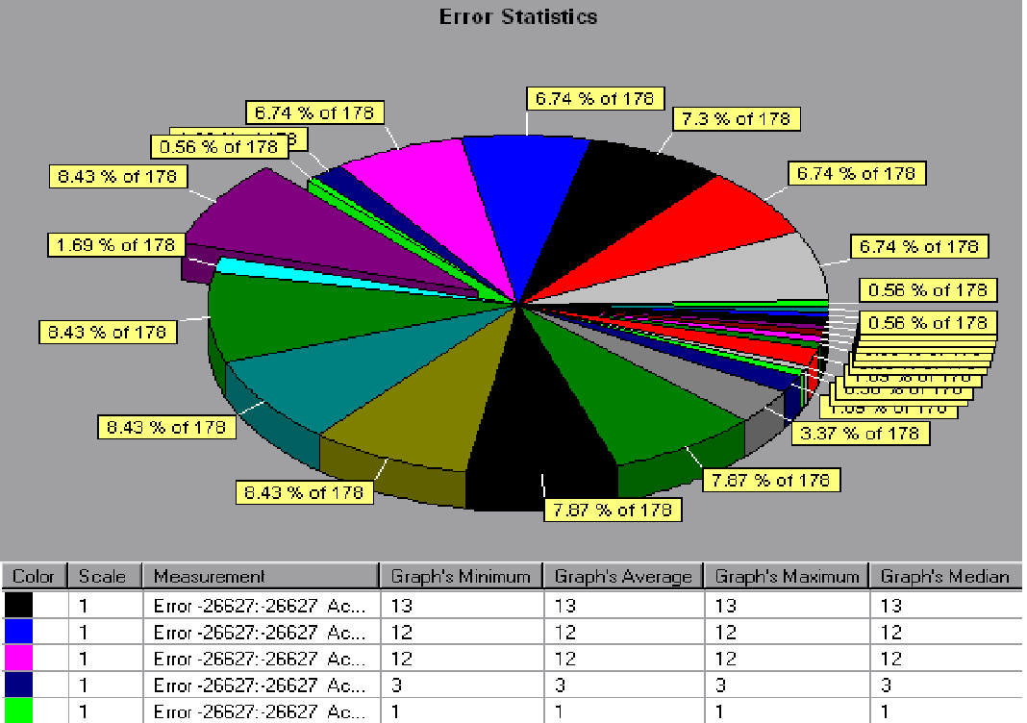
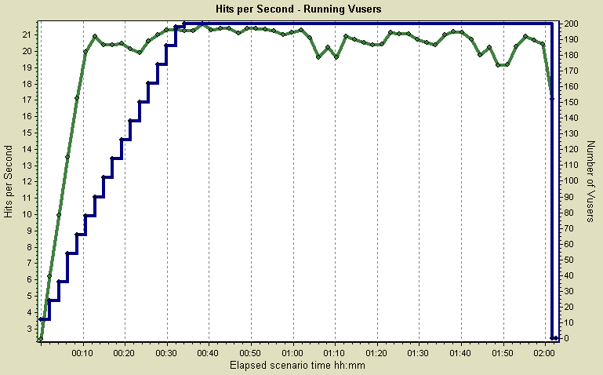
Client Side Statistics
Transaction Response Time
Error Statistics
Hits Per Second

Slide 16
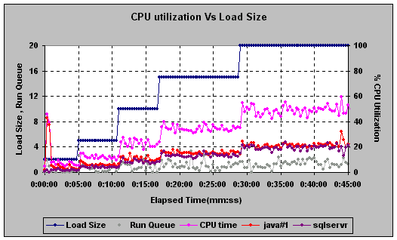
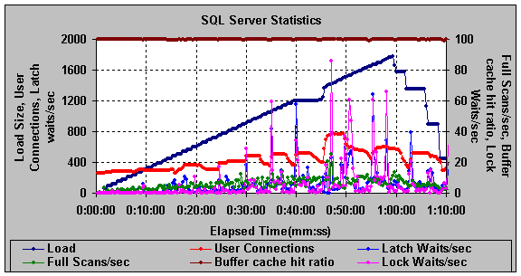
Server Side Statistics
System Statistics
Application Server Statistics
Db Server Statistics

Slide 17
Document references
Performance Testing Artifacts
Testing Stages | Reference Documents to be used for RBT QAL PT
Requirements/Estimation | Virtusa Performance Testing Service Offerings
 | High level Assessment
 | Performance Test Requirement Template
 | Performance Testing Estimation Template
 | Performance Testing Proposal Template
 | Performance User Profiles
 | Tool Evaluation Report
Design & Approach | Performance Test Plan Template
 | Perf_activities - Non Functional Test Activities
 | Perf_scenarios
Execution | Performance Testing Environment checklist
 | Performance Test Cases Development Template
 | Performance Testing Weekly Report Template
Analysis | Performance Test Results Template
 | Performance Testing Customer Results Report Template
 | Performance Testing Handover Document Template

Slide 18
Case study 1 – Typical 400 Vusers test
Load Testing the eFDE application for its performance when the User Load is 400Vus /22 Scripts.
Approximately 3000 Claims need to be released During the Load Test.
During Load Testing, eFDE application was tested with different business processes which are identified in the Load test plan.
Generated valid claims to test the eFDE application performance capabilities.
Monitored the Client side( application ) metrics using the load runner in the Production Environment

Slide 19
Performance Test Approach for eFDE Application
Stages | Activities | Owner
Pre-Requisites | The Production environment should be ready and available for Load Testing | Customer
 | Activate 13 K Claims through Load Runner for Load Test run Test Data | Virtusa
Test Execution and Monitoring | Test Run execution and monitoring the application metrics of the eFDE application functionalities (claims and Non-claims) | Virtusa
Analysis and Reporting | Analyze the Results and publish the Test Run report with observation and Recommendations | Virtusa
Notes:
19

Slide 20
Performance Test - Observations
The system tested is the 10.1.240.108 machine hosted at Customer’s hosting facility in ATLANTA, running on Production platform/Environment.
The simulated load applied to this environment was sized to simulate the peak sustained concurrent load anticipated during the projected average usage period.
We have observed there are many transactions got failed during Load Test Execution due to the application connected timed out error.
Application and Database Servers are UP & Running during Test Executions.
Observed average Transaction Response time of 30 – 50 % of the Pages for all the Business Processes (when the 22 Scripts were running Concurrently with 400 Vusers) is more then as expected which is seems to higher side.
During Load Testing,
Virtual User ramped up till 400 Vusers (i.e., 1Vus at every 01 sec till 400 Vus).
Then dropped to 390 users after clerk ID page during 1st iteration due to failures.
Dropped to 326 users after the process work page in 2nd iteration due to application server connected time out error.
Dropped to 314 users in 3rd iteration
The whole test run took 3.27hrs due to slow response of the pages. It was estimated to run 1.5 hrs. Almost 50% of eFDE application pages got slow response and not scalable
30% pages took more than 100 seconds while some took as long as 200 Sec and most took more than 50 Sec
SQL prepared statements cache was full. It is a setting in WAS and may need to be increased. App is discarding lot of sql prepared statements.
Out of the two JVMs one JVM (which has the higher weight) had the heap at maximum throughout the test most of the time.
CPU utilization was below 50% throughout
DB was at 61% utilization
DB server was at 10% utilization throughout
Application did not crash at any point. App server was up and running throughout the test.
Notes:
20

Slide 21
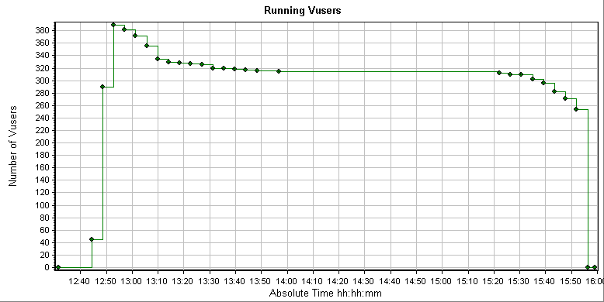
Running Vusers graph
Max concurrent Vusers =390
This line graph shows the impact of Ramp-Up and Ramp-Down specified for run-time. Note the time when the Number of Vusers peaks and when it begins to drop off. This is the "steady state" period of the run.

Slide 22
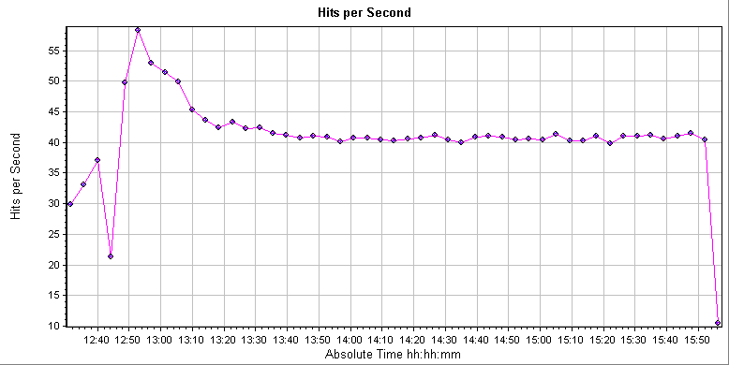
Hits per second graph
Avg. Hits/Sec = 40.957
The one line on this graph helps you evaluate the amount of load Vusers generate, in terms of the number of hits to all web servers. It displays the number of hits made on all Web servers by Vusers during each second of the load test.

Slide 23
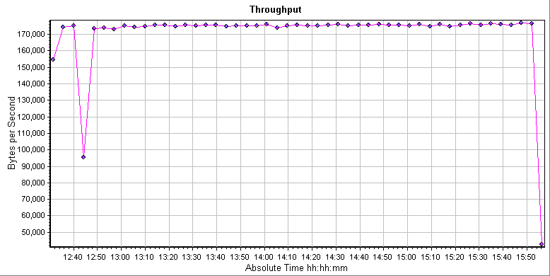
Throughput graph
This line chart helps you to evaluate the amount of load Vusers generate on network resources. It displays the raw amount of bytes that the Vuser client received each second as a result of the hits on the web server during load testing.

Slide 24
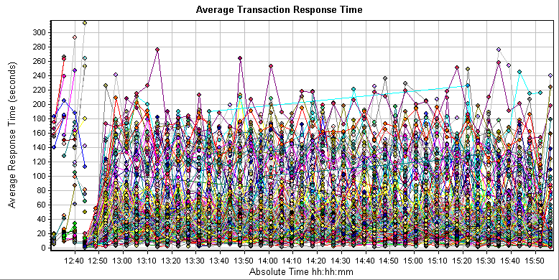
Average Transaction Response Time graph
This line graph is used to determine whether performance is within acceptable minimum and maximum transaction performance time ranges expected of the system. It displays the average time taken to perform transactions during each second of the load test.
Note: Please refer Transactions Response Time stats in Test Report Document Section 5.4.1

Slide 25
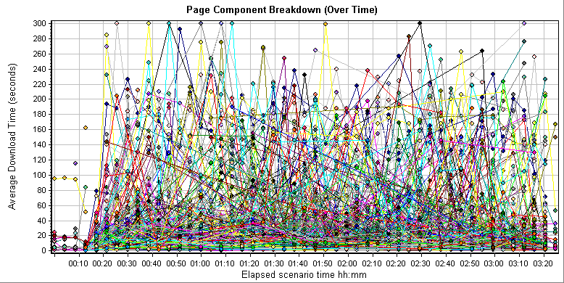
Page Component Breakdown (Overtime) graph
This graph lists the average download time for each transaction action during the Test Run Period. The Page Download Time Breakdown graph displays a breakdown of each page component's download time, enabling you to determine whether slow response times are being caused by network or server errors during Web page download.
Note: Please refer Page Break Down (Over-time) stats in Test Report Document Section 5.4.1

Slide 26
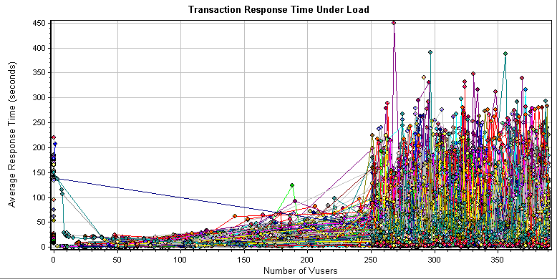
Average Transaction Response Time Under Load graph
This XY graph illustrates how the Number of Vusers impacts Response Time. Typically, individual response times follow an exponential curve up as servers strain to process more Vusers. A flat horizontal line means that response time does not vary, usually because the system has enough (or too much) capacity.

Slide 27
Performance Test – Recommendations
Transaction Tuning: We recommend tuning the application in the business transactions which are taking more response time.
Benefits: In performance experience, performance bottlenecks are attributable to the application code 80% of the time. Improving the performance of business transactions which are taking more response time in all the scenarios, will increase the overall scalability of eFDE application, enabling you to defer the expense of hardware upgrades.
(Note: Please refer Transaction Response Time stats excel sheets define business transactions with response times in section 5.4.1).
Network Tuning: We recommend tuning the Network Parameters.

Slide 28
Case study 2 - PT for workflow process models
Objectives
How to identify workflow models
How to script them
How to execute them
Business processes and its varieties
Single user processes
Multi user processes
User role and its impact
Single user role per process – Direct simulation for load testing
Multiple user role per process – Requires backend preparation

Slide 29
Single user business process. Process flow
User role within a process remains the same
Multiple process threads with defined user roles
Process could be iterative

Slide 30
Single user business process. Scripting approach simulating the loading scenario
Script 1 | 20 Users | 5 iterations
Script 2 | 30 Users | 3 iterations
Script 3 | 50 Users | 1 iteration

Slide 31
Workflow based business process User view
User role within a process could be more than one
Multiple process threads with multiple user roles
Each task is iterative

Slide 32
Workflow based business process Real Office Workflow Scenario
Typical plan for processing 100 new orders for a sales scenario per day
40 Assessments
100 Orders
100 Approvals
100 Dispatches
60 Verifications

Slide 33
Workflow based business process Scripting approach
Script 2
Role -Assessor Work Item - Assessment 2 V-users
20 Iterations
Script 1
Role -Sales Person Work Item -New order 5 V-users
20 Iterations
Script 5
Role - Dispatcher Work Item – Dispatch 5 V-users
20 Iterations
Script 3
Role -Verifier Work Item -Verify order 3 V-users
20 Iterations
Script 4
Role -Approver Work Item -Approver 5 V-users
20 Iterations

